Slide 1
Measuring Planck’s Constant by Observation of the Photoelectric Effect

Slide 2
Theory
Photoelectric Effect: Electrons can be ejected from a metal irradiated by electromagnetic radiation.
Electrons bound to metal by binding energy
Increased frequency: increased electron kinetic energy

Slide 3
Theory
Albert Einstein: light is made of particles called photons
Photons carry energy proportional to the frequency of the light
Increased intensity: more photons, but not more energy in each photon

Slide 4
Experiment
Irradiate a metal cathode with light of a known frequency and measure the produced photocurrent
Vary the voltage between cathode and anode to find the stopping voltage.
Repeat for several wavelengths of light.
By energy conservation, we have:
|V_{s}| = (hc/e) (1/λ) + Φ/e

Slide 5
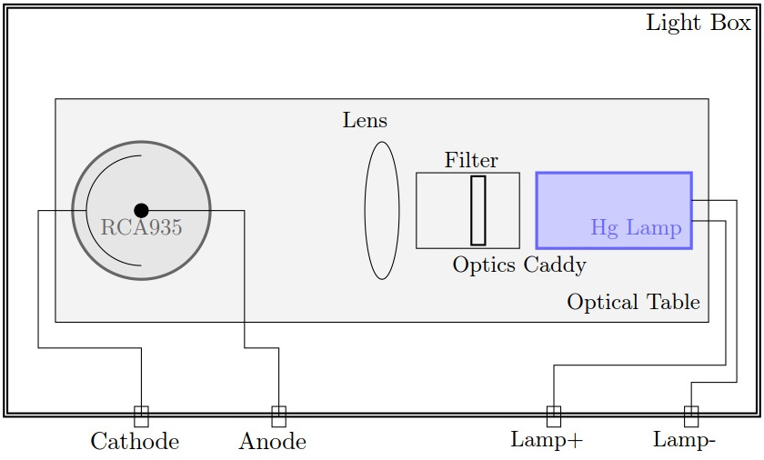
Experimental Setup

Slide 6
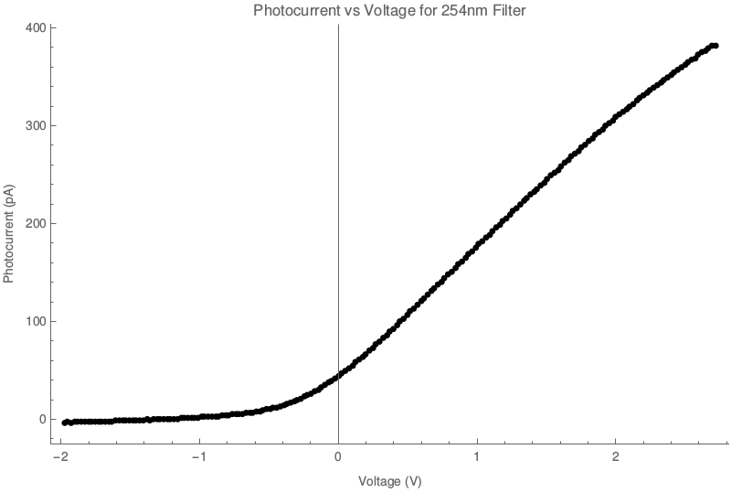
Current Vs. Voltage Graph

Slide 7
Determination of Stopping Potential
Used a statistical technique.
Fit a line to the first thirty data points.
Calculated the standard deviation of these points from the fitted line.
Found a critical line, which was the best fit line shifted up three standard deviations.
Defined the stopping potential to be the voltage that corresponded to the first data point for which all subsequent points lie above the critical line.

Slide 8
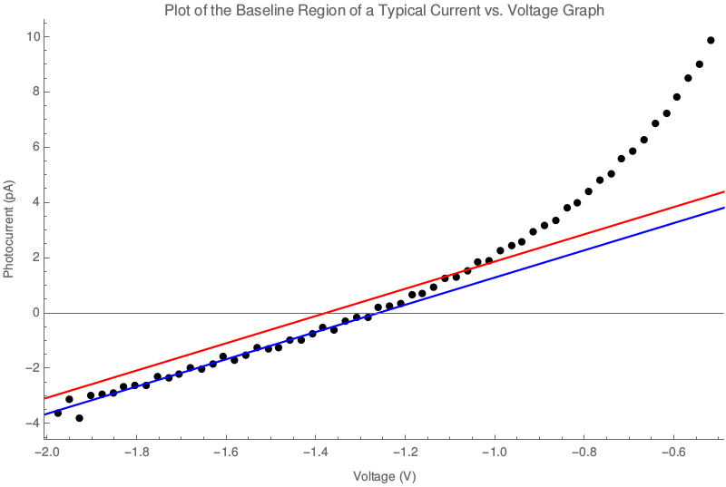

Slide 9
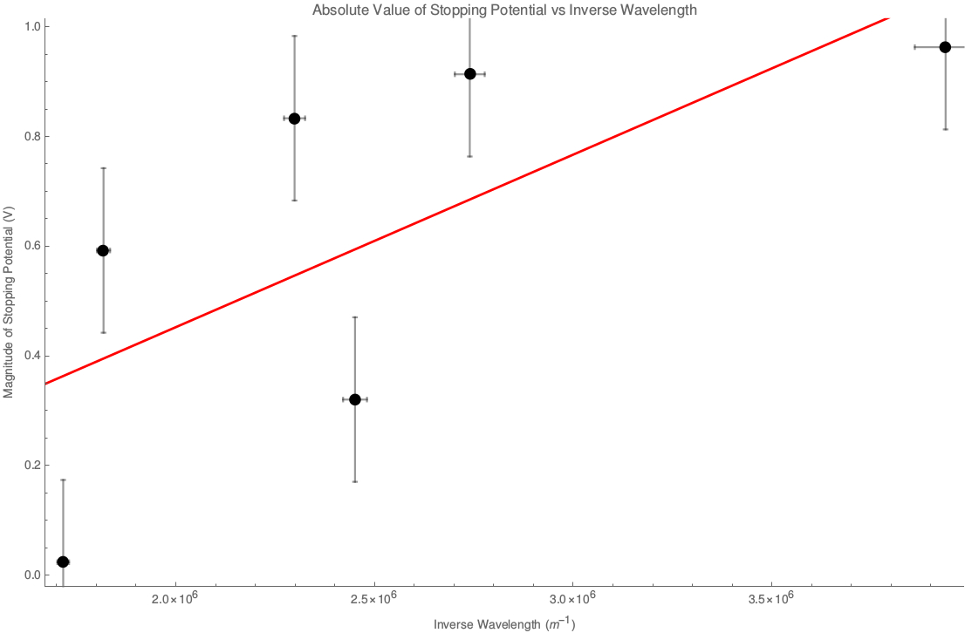
Results

Slide 10
Results
Best fit line: |V_{s}| = (3.1 × 10⁻⁷ ± 0.8 × 10⁻⁷ Vm) (1/λ) + (−0.2 ± 0.2 V)
This implies values of:
h = 1.6 × 10⁻³⁴ ± 0.4 × 10⁻³⁴ Js
Φ = −0.2 ± 0.2 eV
These results do not agree with the accepted values of these quantities.

Slide 11
Errors in Results
Noise in the current measurements.
Excessive photoemission from the anode.
Filters having an unknown effect on the incident light.

